Slide 1
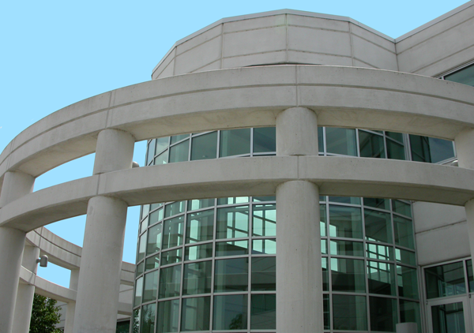
GE Healthcare
MR Safety Precautions
Classification: A

Slide 2
MR Safety Precautions
Personal protective equipment (PPE) and using a qualified Work Assistant / Observer are two aspects of working with MR that you can control to protect yourself. Even after you have successfully serviced MR equipment many times, it is important to always respect the dangers involved.
After completing this section you will be able to use safety precautions when servicing MR equipment.
You will do this by:
Understanding that two (2) MR safety trained personnel must be present at all times when servicing highly ferrous devices in the areas of magnetic fields.
Identifying PPE required when servicing MR equipment.
Understanding the training and completed forms required to become a Second Person-Work Assistant / Observer.
Understanding additional MR specific hazards: high voltages, biasing, RF energy and pinch points.
Notes:
Safety Precautions
Personal protective equipment and the buddy system are two aspects of working with MR that you can control to protect yourself. Even after you have successfully serviced MR equipment many times, it is important to always respect the dangers involved.
After completing this section you will be able to use safety precautions when servicing MR equipment.
You will do this by:
Identifying the personal protective equipment (PPE) required when servicing MR equipment.
Explaining the reasons for having the buddy system.

Slide 3
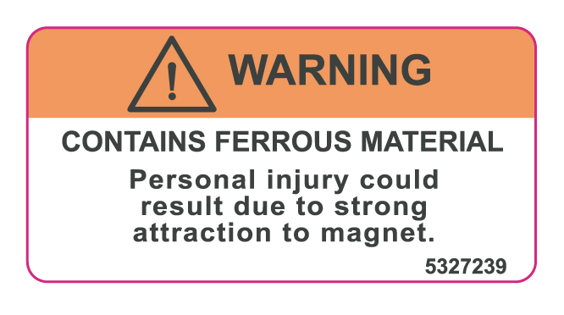
MR Safety Precautions
  The need to take proper precautions when servicing highly ferrous components in a magnetic environment is critical. Failure to do so may result in death or serious injury to service engineers.
  There is an explicit service policy to follow when servicing highly ferrous devices in a magnetic field. Components such as (click on each sub-bullet to view images):
    Dock assemblies
    Longitudinal Drive Motor assemblies
    Blower Boxes
    Passive Shims
    Coldheads
    are examples of highly ferrous devices that fall under this policy. These items typically have WARNING stickers applied to them.
Notes:
Safety Precautions
Personal protective equipment and the buddy system are two aspects of working with MR that you can control to protect yourself. Even after you have successfully serviced MR equipment many times, it is important to always respect the dangers involved.
After completing this section you will be able to use safety precautions when servicing MR equipment.
You will do this by:
Identifying the personal protective equipment (PPE) required when servicing MR equipment.
Explaining the reasons for having the buddy system.

Slide 4
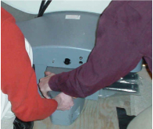
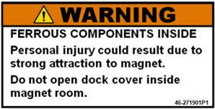
MR Safety Precautions
  The need to take proper precautions when servicing highly ferrous components in a magnetic environment is critical. Failure to do so may result in death or serious injury to service engineers.
  There is an explicit service policy to follow when servicing highly ferrous devices in a magnetic field. Components such as (click on each sub-bullet to view images):
    Dock assemblies
    Longitudinal Drive Motor assemblies
    Blower Boxes
    Passive Shims
    Coldheads
  X click to close
Notes:
Safety Precautions
Personal protective equipment and the buddy system are two aspects of working with MR that you can control to protect yourself. Even after you have successfully serviced MR equipment many times, it is important to always respect the dangers involved.
After completing this section you will be able to use safety precautions when servicing MR equipment.
You will do this by:
Identifying the personal protective equipment (PPE) required when servicing MR equipment.
Explaining the reasons for having the buddy system.

Slide 5
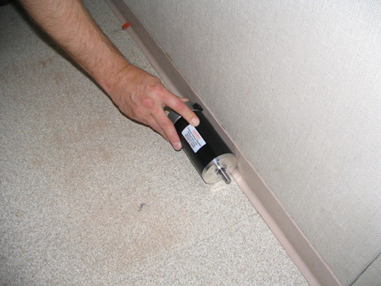
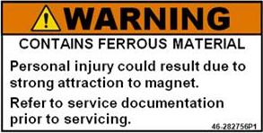
MR Safety Precautions
  The need to take proper precautions when servicing highly ferrous components in a magnetic environment is critical. Failure to do so may result in death or serious injury to service engineers.
  There is an explicit service policy to follow when servicing highly ferrous devices in a magnetic field. Components such as (click on each sub-bullet to view images):
    Dock assemblies
    Longitudinal Drive Motor assemblies
    Blower Boxes
    Passive Shims
    Coldheads
  X click to close
Notes:
Safety Precautions
Personal protective equipment and the buddy system are two aspects of working with MR that you can control to protect yourself. Even after you have successfully serviced MR equipment many times, it is important to always respect the dangers involved.
After completing this section you will be able to use safety precautions when servicing MR equipment.
You will do this by:
Identifying the personal protective equipment (PPE) required when servicing MR equipment.
Explaining the reasons for having the buddy system.

Slide 6
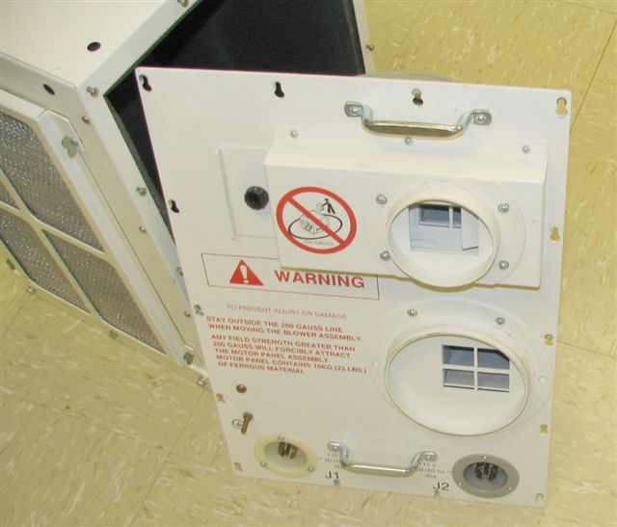
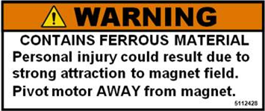
MR Safety Precautions
  The need to take proper precautions when servicing highly ferrous components in a magnetic environment is critical. Failure to do so may result in death or serious injury to service engineers.
  There is an explicit service policy to follow when servicing highly ferrous devices in a magnetic field. Components such as (click on each sub-bullet to view images):
    Dock assemblies
    Longitudinal Drive Motor assemblies
    Blower Boxes
    Passive Shims
    Coldheads
  X click to close
Notes:
Safety Precautions
Personal protective equipment and the buddy system are two aspects of working with MR that you can control to protect yourself. Even after you have successfully serviced MR equipment many times, it is important to always respect the dangers involved.
After completing this section you will be able to use safety precautions when servicing MR equipment.
You will do this by:
Identifying the personal protective equipment (PPE) required when servicing MR equipment.
Explaining the reasons for having the buddy system.

Slide 7
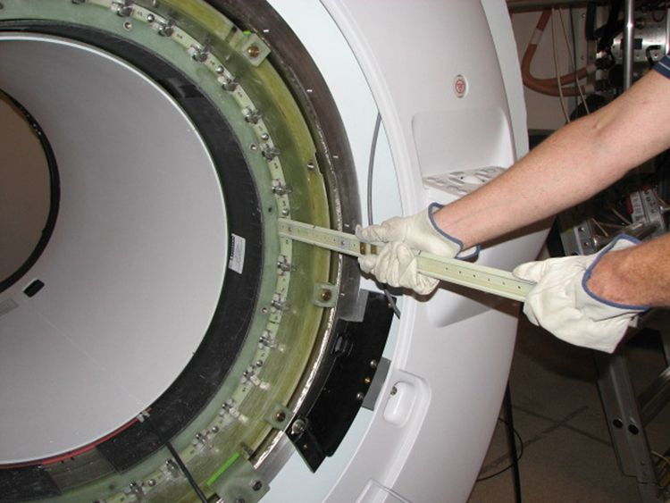
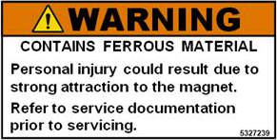
MR Safety Precautions
  The need to take proper precautions when servicing highly ferrous components in a magnetic environment is critical. Failure to do so may result in death or serious injury to service engineers.
  There is an explicit service policy to follow when servicing highly ferrous devices in a magnetic field. Components such as (click on each sub-bullet to view images):
    Dock assemblies
    Longitudinal Drive Motor assemblies
    Blower Boxes
    Passive Shims
    Coldheads
  X click to close
Notes:
Safety Precautions
Personal protective equipment and the buddy system are two aspects of working with MR that you can control to protect yourself. Even after you have successfully serviced MR equipment many times, it is important to always respect the dangers involved.
After completing this section you will be able to use safety precautions when servicing MR equipment.
You will do this by:
Identifying the personal protective equipment (PPE) required when servicing MR equipment.
Explaining the reasons for having the buddy system.

Slide 8
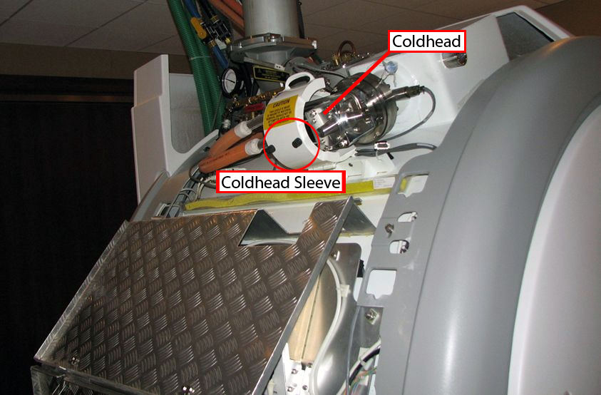
MR Safety Precautions
  The need to take proper precautions when servicing highly ferrous components in a magnetic environment is critical. Failure to do so may result in death or serious injury to service engineers.
  There is an explicit service policy to follow when servicing highly ferrous devices in a magnetic field. Components such as (click on each sub-bullet to view images):
    Dock assemblies
    Longitudinal Drive Motor assemblies
    Blower Boxes
    Passive Shims
    Coldheads
  X click to close
Notes:
Safety Precautions
Personal protective equipment and the buddy system are two aspects of working with MR that you can control to protect yourself. Even after you have successfully serviced MR equipment many times, it is important to always respect the dangers involved.
After completing this section you will be able to use safety precautions when servicing MR equipment.
You will do this by:
Identifying the personal protective equipment (PPE) required when servicing MR equipment.
Explaining the reasons for having the buddy system.

Slide 9
Service Policy When Servicing Highly Ferrous Devices in a Magnetic Field
When servicing any magnetic equipment, it is critically important that the service engineer consciously plan the path to be taken when moving highly ferrous devices in the magnet environment. The path should be as far from the magnet as practical and avoid high flux-density fields.
Safety Requirement
Movement of ferrous material in the magnet room must follow the GE service procedure for that device.
  When exiting, move away from the magnet in the most direct manner possible.
  Except when moving ferrous material to/from its native location on or near the magnet, the static magnetic field in any portion of the service path shall not exceed 200 gauss (refer to the appropriate Pre-Installation Manual [PIM] to better understand the location of the 200 gauss line for your magnet type).
Notes:
Safety Precautions
Personal protective equipment and the buddy system are two aspects of working with MR that you can control to protect yourself. Even after you have successfully serviced MR equipment many times, it is important to always respect the dangers involved.
After completing this section you will be able to use safety precautions when servicing MR equipment.
You will do this by:
Identifying the personal protective equipment (PPE) required when servicing MR equipment.
Explaining the reasons for having the buddy system.

Slide 10
Service Policy When Servicing Highly Ferrous Devices in a Magnetic Field
Safety Requirement
  When planning a service path, it is critical that the path be clear and sufficiently wide.
    Ensure there are no trip hazards, obstacles, clutter, slippery surfaces, or any other items even partially restricting the path.
    If there are portable obstacles in a path, temporarily remove them from the area and replace them after the service action is completed.
  It is required to walk the paths prior to beginning service to ensure there is sufficient space through which to pass for yourself and the object being serviced.
!
Important: Two MR safety trained personnel must be present at all times when servicing highly ferrous devices in the areas of magnetic fields.
Notes:
Safety Precautions
Personal protective equipment and the buddy system are two aspects of working with MR that you can control to protect yourself. Even after you have successfully serviced MR equipment many times, it is important to always respect the dangers involved.
After completing this section you will be able to use safety precautions when servicing MR equipment.
You will do this by:
Identifying the personal protective equipment (PPE) required when servicing MR equipment.
Explaining the reasons for having the buddy system.

Slide 11
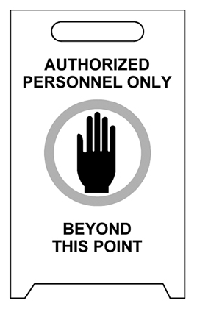
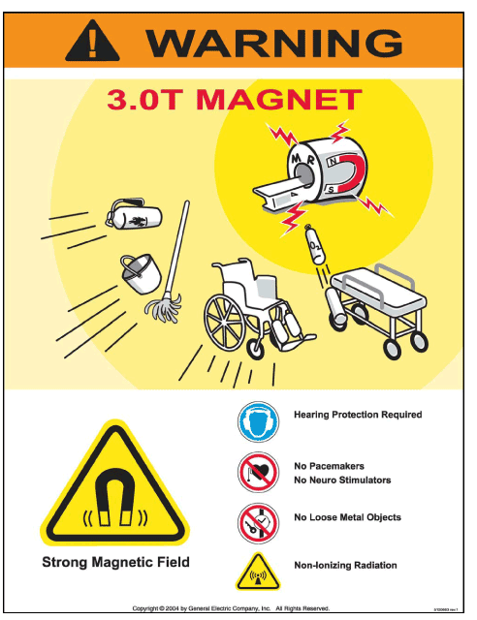
Magnet Field Safety Requirements
  Make sure you read all of Magnet Field Safety Requirements BEFORE you do any work and that the highly visible security / warning signs are posted.

Slide 12
MR Safety Precautions
  The MR Magnet – Safety Requirements have been updated. Always follow the latest documentation http://3.87.118.28/optec3/common/serv.htm.
  Click here to view to the September 2010 updated table with new items highlighted.
  Updates on the table include:
    A new column “Servicing Highly Ferrous Material in Magnet Room”
    Item 7: Second person present and trained in safety practices for procedure being performed.
    Item 13: Inspect the Service Platform thoroughly prior to use. Make sure the platform is in acceptable condition.
    Item 41: Plan clear service path without obstacles and wide enough to walk through with the device being serviced. The path should be as far from the magnet as practical, avoid high flux density fields and as much as possible in a field strength of less than 200 gauss.
    New Servicing Highly Ferrous Material in Magnet Room column also applies to Item 9, 12, 14, 21, 22 and 40.
Notes:
Safety Precautions
Personal protective equipment and the buddy system are two aspects of working with MR that you can control to protect yourself. Even after you have successfully serviced MR equipment many times, it is important to always respect the dangers involved.
After completing this section you will be able to use safety precautions when servicing MR equipment.
You will do this by:
Identifying the personal protective equipment (PPE) required when servicing MR equipment.
Explaining the reasons for having the buddy system.

Slide 13
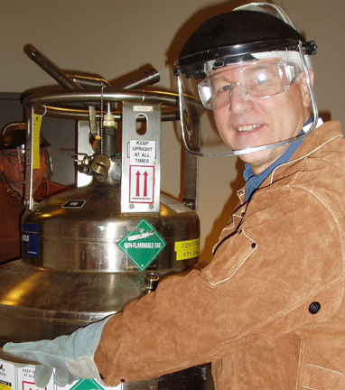
Personal Protective Equipment (PPE)
PPE includes the following:
For your:
  Face
  Hands
  Body
  Feet
Notes:
Personal Protective Equipment (PPE)
PPE includes the following:
For your face: safety glasses with side shields or goggles and a face shield
For your hands: Loose-fitting, insulated cryogen gloves
For your body: Long-sleeved shirt, shop apron or other protective covering, welder's jacket, long pants with no cuffs-worn outside shoes or boots
For your feet: Composite toe safety shoes that are insulated and water repellant
Obtaining PPE

Slide 14
Face
Both liquid nitrogen and liquid helium can cause severe frostbite and eye damage. Therefore:
Wear safety glasses with side shields or goggles
Wear a face shield anytime liquid cryogens may spray under pressure
Notes:
Face
Both liquid nitrogen and liquid helium can cause severe frostbite and eye damage. It is vital that you protect your eyes because they are the only body part that will not regenerate when damaged by cryogens. Therefore:
Wear safety glasses with side shields or goggles anytime you are working with cryogens.
Wear a face shield anytime liquid cryogens may spray under pressure.

Slide 15
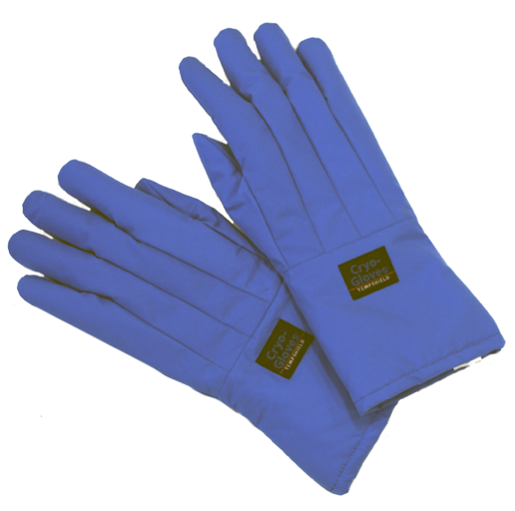
Hands
To protect your hands:
Use insulated gloves to protect your hands from frostbite
Gloves should be loose-fitting so you can quickly remove them
Understand the limitations of the gloves
Notes:
Hands
To protect your hands:
Your gloves must be insulated to protect your hands from frostbite.
Gloves should be loose-fitting so you can quickly remove them if they should become saturated with the liquid cryogens.
Gloves should be loose enough to be flipped off of your hand. Grabbing the glove can force the cryogenic fluid through the material and into contact with your skin.

Slide 16
Body
To protect your body:
Wear long sleeves and long pants
A wind breaker, shop apron, welder's jacket, or leather vest will help repel any liquid that might splash
Notes:
Body
To protect your body:
Wear long sleeves and long pants to ensure that no skin is exposed.
A wind breaker, shop apron, welder's jacket, or leather vest will help repel any liquid that might splash. These items differ in cost and degree of protection. They may also limit your mobility when working.

Slide 17
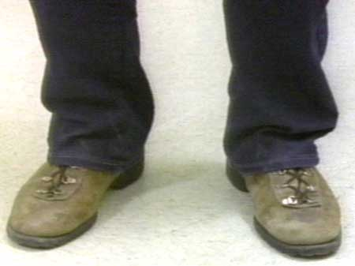
Feet
Composite toe safety shoes will:
Protect your toes from being crushed
Ensure your safety when working around newer, higher-powered magnets
Notes:
Feet
Composite toe safety shoes will
Protect your feet from splashed liquid, and
Ensure your safety when working around newer, higher-powered magnets.

Slide 18
Ordering PPE
Safety glasses, face shield, and cryogen gloves:
Item | Part number
Safety Kit | 46-271137G1
Safety shoes:
Composite toe safety shoes are available through the EHS safety shoe program and are required for MR engineers
Welder's jacket or shop apron:
The welder's jacket can be purchased locally from any welding supply house or gas distributor
Notes:
Ordering PPE
Safety glasses, face shield, and cryogen gloves
These are contained in the following Air Products safety kit.
Item Part number
Safety Kit 46-271137G1
Safety shoes
Composite toe safety shoes are available through the EHS safety shoe program and are required for MR engineers.
Welder's jacket or shop apron
The welder's jacket costs approximately $50 and is purchased locally from any welding supply house or gas distributor.
A shop apron is less desirable, but can also be purchased locally from any industrial supply house.

Slide 19
Second Person – Work Assistant / Observer
  A Second Person – Work Assistant / Observer is more than just a second person who is "around" while you are working. They are someone who will maintain communication with you at all times and can render appropriate assistance in the event of an emergency.
  Click here to view the Second Person – Work Assistant/Observer Requirements form updated as of September 2010.
    Table 2 is to be completed by the individual that is being certified to function as either a Work Assistant or Work Observer. She or he must certify that s/he posses the qualifications of a “Second Person”, and initial the appropriate “Assistant” or “Observer” column to show s/he has been certified.
    The Primary Field Engineer must keep this completed form on site.
Notes:
Buddy System (Screen 2 of 2)
A buddy is more than just a second person who is "around" while you are working. A buddy is someone who will maintain communication with you at all times and can render appropriate assistance in the event of an emergency.
The buddy must:
Have an MR safety Questionnaire on file, and
Meet the criteria outlined in the MR Buddy System Checklist.
When you are working with another field service engineer, you are each other's buddies. You both need to be watching each other for cryogen related effects. In addition, you should not be working in the same environment; you may both be overcome.

Slide 20
Second Person – Work Assistant / Observer
  Click here to view the Certification Agreement form updated as of October 2010.
    Table 3 is to be completed by the Field Engineer and the Observer.
    The Primary Field Engineer must keep this completed form on site.
  NEVER employ an untrained person since this has the potential to place your life as well as theirs in jeopardy.
  Your safety is YOUR most important responsibility
    A magnet ramp down may be necessary to perform procedures.
    Contact local support engineer or OnLine Center with questions regarding a safe working environment.
  Click here for October 2010 Service Note update.
Notes:
Buddy System (Screen 2 of 2)
A buddy is more than just a second person who is "around" while you are working. A buddy is someone who will maintain communication with you at all times and can render appropriate assistance in the event of an emergency.
The buddy must:
Have an MR safety Questionnaire on file, and
Meet the criteria outlined in the MR Buddy System Checklist.
When you are working with another field service engineer, you are each other's buddies. You both need to be watching each other for cryogen related effects. In addition, you should not be working in the same environment; you may both be overcome.

Slide 21
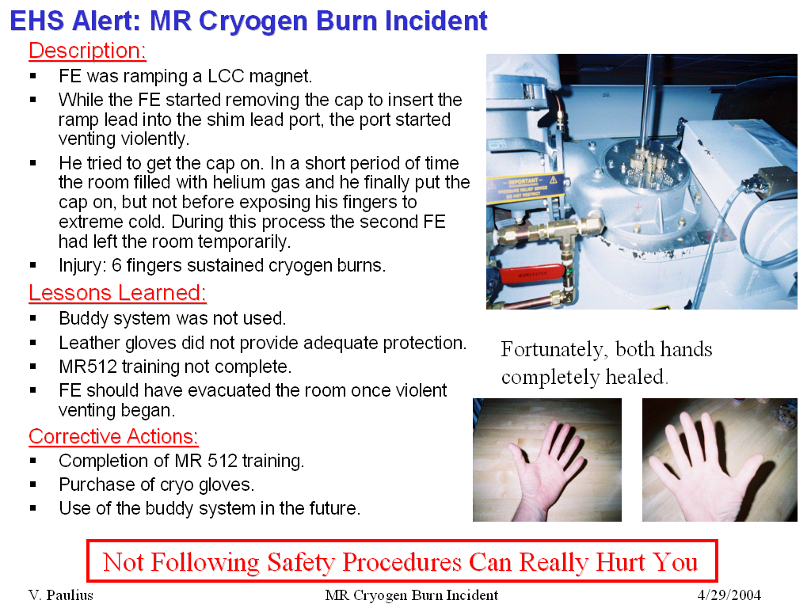
EHS Alert: MR Cryogen Burn Incident
Description:
  FE was ramping a LCC magnet.
  While FE started removing the cap to insert the ramp lead into the port, the port started venting violently.
  He tried to get the cap on. In a short period of time the room filled with helium gas and he finally put the cap on, but not before exposing his fingers to extreme cold. During this process the second FE had left the room temporarily.
  Injury: 6 fingers sustained cryogen burns.
Fortunately both hands completely healed
Not Following Safety Procedures Can Really Hurt You

Slide 22
EHS Alert: MR Cryogen Burn Incident
Lessons Learned:
  Second Person – Work Assistant / Observer was not used properly.
  Leather gloves did not provide adequate protection.
  MR512 (Magnet & Cryogen Safety) training not completed.
  FE should have evacuated the room once violent venting began.
  Corrective Actions:
  Completion of MR 512 training.
  Purchase of new cryo gloves.
  Proper use of the Second Person – Work Assistant / Observer in the future.
Fortunately both hands completely healed
Not Following Safety Procedures Can Really Hurt You

Slide 23
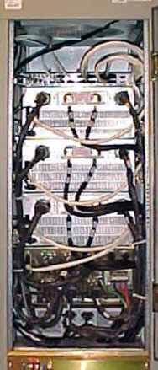
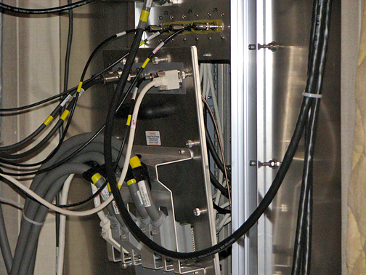
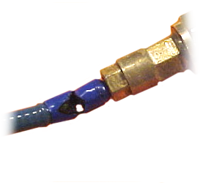
RF Energy/High Voltage/Biasing
Primary Concerns:
  RF Burns
  Electrical Shock
High Voltage Bias Lines
RF Energy
High Voltage

Slide 24


Use Caution When Lifting (1 of 2)
PERSONAL INJURY.
THE SRFD2 MODULE WEIGHS 200 LB (91 KG).
THE UNIVERSAL HOIST KIT IS REQUIRED TO REMOVE/REPLACE THE MODULE FROM THE CABINET.
CABINET TIP HAZARD! POSSIBLE PERSONAL INJURY!
THE RF CABINET WILL TIP OVER IF THE RF AMPLIFIER IS EXTENDED WITHOUT ANTI-TIP LEGS BEING INSTALLED.
CONFIRM THAT THE ALUMINUM ANTI-TIP LEGS STORED IN THE REAR OF THE CABINET ARE INSTALLED ON EITHER SIDE OF THE BASE OF THE CABINET BEFORE ATTEMPTING TO REMOVE AN RF AMPLIFIER.

Slide 25

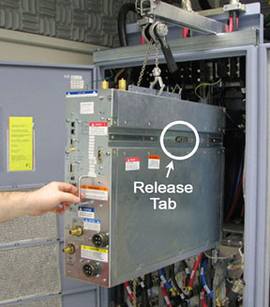
Use Caution When Lifting (2 of 2)
Use appropriate hoist kit when lifting anything that weighs over 35 pounds.
Possible personal injury or equipment damage!
The module could fall when using lift tool.
Before putting weight on the hoist chain, be sure that the links are aligned properly. This will help keep the chain from binding up or becoming kinked, which is nearly impossible to correct when the chain is under tension.

Slide 26


Be Aware of All Hazards Stated in the Procedures
FATAL ELECTRIC SHOCK HAZARD!!
POSSIBLE 800 VOLTS ON CAPACITORS.
WAIT AT LEAST 5 MINUTES AFTER UNIT HAS BEEN TURNED OFF BEFORE SERVICING. TO PREVENT ELECTRIC SHOCK, DISCONNECT POWER FROM THE PDU BEFORE YOU PERFORM THE FOLLOWING PROCEDURES. PERFORM LOCKOUT / TAGOUT PROCEDURE PER GE OSHA LOCKOUT / TAGOUT REQUIREMENTS LISTED IN THE FIELD SERVICE EHS MANUAL & TRAINING 2000 P/N 2135387-200.
FATAL ELECTRIC SHOCK HAZARD!
THE GRADIENT Amplifiers ACT AS CONSTANT LOAD SOURCES, AND WILL SEND maximum CURRENT TO ANY LOAD including any human who get across the outputs.
TO PREVENT FATAL ELECTRIC SHOCK, ENSURE THAT POWER IS OFF TO the gradient subsystem before CONTINUING WITH THIS PROCEDURE.
POSSIBLE PERSONAL INJURY!
THIS PROCEDURE REQUIRES REMOVAL OF FERROUS MATERIAL IN CLOSE PROXIMITY TO THE MAGNET.
Therefore, two Field engineers are required at all times.

Slide 27
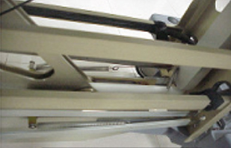
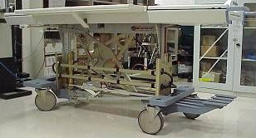
Be Aware of Potential Pinch Points on Table
PERSONAL INJURY POSSIBILITY!
SEVERE PERSONAL INJURY CAN OCCUR IF TABLE IS ACCIDENTALLY LOWERED DURING MAINTENANCE PERFORMANCE.
WHEN PERFORMING MAINTENANCE ON THE TABLE IN ITS UP POSITION, ENSURE THAT THE LOCK BAR IS SAFELY IN PLACE.

Slide 28
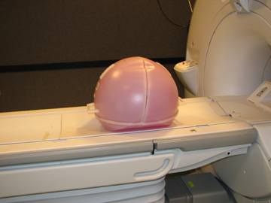
Large Volume Shim Phantom Can Pinch Fingers

Slide 29

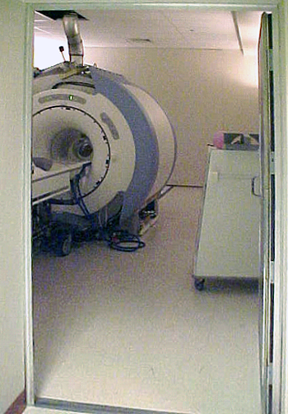
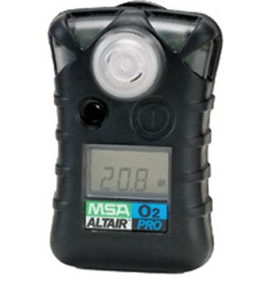
Compressed Gasses and Cryogens
Primary Concern
Asphyxiation:
  Proper ventilation for asphyxiation protection.
  KEEP THE SCAN ROOM DOOR PROPPED OPEN when in the scan room.
  Use your portable Oxygen Sensor monitor.

Slide 30
Summary
  Using safety precautions and having the proper training to service MR equipment will prevent accidents.
  Using non-ferrous tools (titanium only in 3T), PPE, and employing a qualified second person when necessary will make the magnet room area a safer environment to work in.
  Be sure to follow the latest revision service procedure and read / understand the safety sections.

